Slide 1
What is SoC?
A system on chip (SoC) is an integrated circuit that integrates all components of a computer or other electronic systems.
It may contain digital, analog, mixed-signal, and often radio-frequency functions—all on a single substrate.
SoCs are very common in the mobile computing market because of their low power consumption

Slide 2
A typical SoC consists of:
a microcontroller, microprocessor or digital signal processor (DSP) core – multiprocessor SoCs (MPSoC) having more than one processor core
memory blocks including a selection of ROM, RAM, EPROM and flash memory
timing sources including oscillators and phase-locked loops
peripherals including counter-timers, real-time timers and power-on reset generators
external interfaces, including industry standards such as USB, FireWire, Ethernet, USART, SPI
analog interfaces including ADCs and DACs
voltage regulators and power management circuits

Slide 3
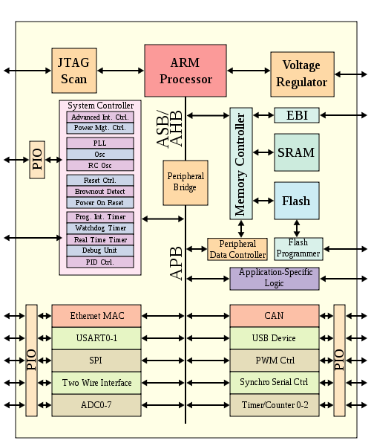

Slide 4
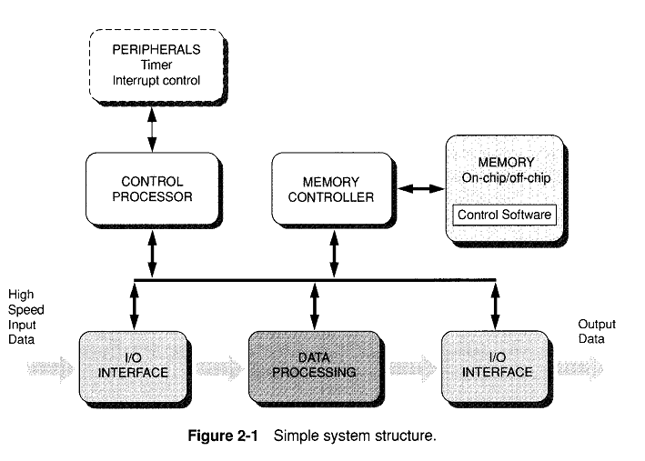
Hardware System Structure

Slide 5
This partitioning into control and data flows works well when:
The data processing is simple but very demanding in efficiency
The control functions are complex but not performance demanding
Control functions can be implemented as software tasks running on a general-purpose embedded processor.
Data processing can be implemented as hardwired logic for speed.
The control and data-processing subsystems communicate through memory.

Slide 6
The likelihood of design changes is a key issue when making a partition between control and data-processing functions.
These changes could include new specifications, evolving market requirement, etc.
Changes in the control subsystem can easily be accommodated by changes in software task.
Changes in the hardware-based data-processing function are harder to achieve.

Slide 7
RTL
Many advantages over the custom transistor-level circuit design:
Effectively exploits the intrinsic concurrency of many data-intensive problems
Can achieve tens or hundreds of times the performance of custom transistor-level circuit design
These advantages arise from two essential characteristic :
It implements the sequence of operations by making the operands flow from the output of one operation directly to the input of next. So no waste occurs.
Natural concurrency of one operation independent of other operations is expressed directly.

Slide 8
Most of the functions are implemented using finite state machines, data-path logic and local memory.
A single finite sate machine can control an entire data path.
Most of the time, many finite sate machines are there; one is a master controlling slave state machines.
If a late change is made in an RTL block, the change is more likely to affect the state machine than the structure of data path.

Slide 9
Hardware Trends
As semiconductor device density increases, some trends in hardware design are emerging to increase the difficulty and risk of this traditional development model:
Higher complexity
Greater concern over power dissipation
New deep-submicron effects
Heavier simulation load
More fabrication choices

Slide 10
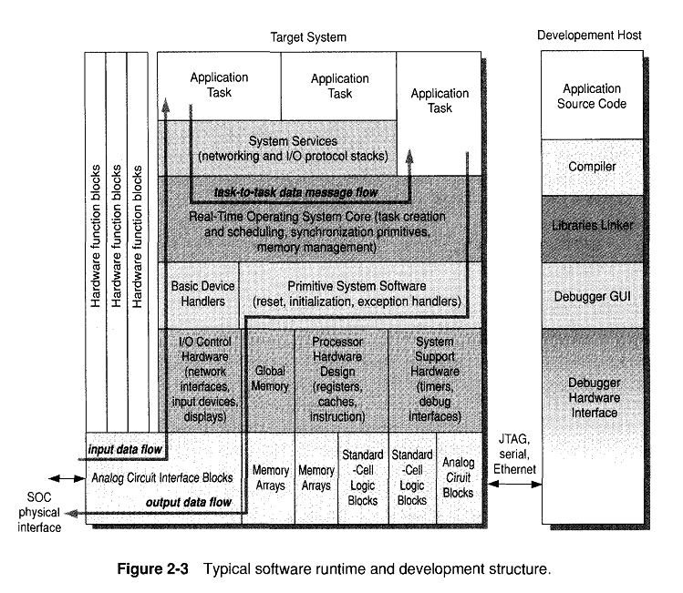
Software Structure

Slide 11
Typical target-system software components in software structure of majority of the complex systems include:
Low-level device reset and exception-handling code
Standard operating system services for resource management, task initialization, scheduling and communication
Networking and other protocol stacks
A number of application tasks that implement the major externally visible system functions.
The development system includes the tools needed to build and test individual software components and to run and debug the combination of components on target-system simulation models.

Slide 12
Effects of hardware and software complexity
Increasing hardware complexity makes models more expensive to develop and expands the number of hardware/software interfaces to consider.
Increasing software complexity drives the need for sophisticated layering of operating systems and system services and mandates sophisticated debugging tools.

Slide 13
Software Trends
SOC complexity is growing and software generally handles complexity more gracefully than hardware. Nevertheless, two software trends that are worth noting are:
Virtual prototyping
Multiple processors

Slide 14
Current SOC Design Flow
Many of the key architectural decisions are made early in the design process long before any detailed performance or implementation feedback is available.
The long delay from key algorithm selection and system-performance measurement on hardware simply increases the risk and cost of fixing issues.
Current SOC design flow has been divided into three dimensions:
Architecture design
Software design
Hardware design

Slide 15
Designers want an SOC that is as small, fast and efficient as possible. Therefore, number of design blocks increase with increase in number of features.
Preliminary estimates from block diagram, floor plans and RTL code are crude and optimistic, so the simulated must be changed in accordance with the actual real world design.
Changes in interface, size, timing, etc. of one block will propagate to other blocks, triggering even more design changes.
Growing chip complexity also mandates more blocks which means more gates and wires increasing wire lengths which means more wire delay, less efficient performance and more power dissipation.

